Slide 1
Shall we Dance?
ESV
Ex. 15:20 Then Miriam the prophetess, the sister of Aaron, took a tambourine in her hand, and all the women went out after her with tambourines and dancing.
2 Sam. 6:14 And David danced before the Lord with all his might.

Slide 2
Shall we dance?
What is dancing?
What is harmless?
What is wrong?

Slide 3
What is dancing?
ESV
Merriam-Webster online: “to move your body in a way that goes with the rhythm and style of music that is being played.”
2 Sam. 6:14-15 And David danced before the Lord with all his might. And David was wearing a linen ephod. ¹⁵ So David and all the house of Israel brought up the ark of the Lord with shouting and with the sound of the horn. ¹⁶ As the ark of the Lord came into the city of David, Michal the daughter of Saul looked out of the window and saw King David leaping and dancing before the Lord, and she despised him in her heart.

Slide 4
What is dancing?
ESV
Merriam-Webster online: “to move your body in a way that goes with the rhythm and style of music that is being played.”
Ex. 15:19-21 For when the horses of Pharaoh with his chariots and his horsemen went into the sea, the Lord brought back the waters of the sea upon them, but the people of Israel walked on dry ground in the midst of the sea. ²⁰ Then Miriam the prophetess, the sister of Aaron, took a tambourine in her hand, and all the women went out after her with tambourines and dancing. ²¹ And Miriam sang to them: “Sing to the Lord, for he has triumphed gloriously; the horse and his rider he has thrown into the sea.”

Slide 5
Jer. 31:4 Thus says the Lord: “The people who survived the sword found grace in the wilderness; when Israel sought for rest, ³ the Lord appeared to him from far away. I have loved you with an everlasting love; therefore I have continued my faithfulness to you. ⁴ Again I will build you, and you shall be built, O virgin Israel! Again you shall adorn yourself with tambourines and shall go forth in the dance of the merrymakers.
ESV

Slide 6
Mal. 4:1-2 “For behold, the day is coming, burning like an oven, when all the arrogant and all evildoers will be stubble. The day that is coming shall set them ablaze, says the Lord of hosts, so that it will leave them neither root nor branch. ² But for you who fear my name, the sun of righteousness shall rise with healing in its wings. You shall go out leaping like calves from the stall.
ESV

Slide 7
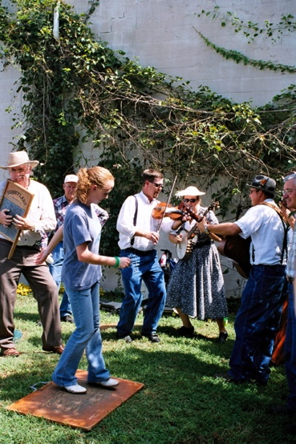
“The Rockdale Ridge Runners at Paint Rock Valley” by Hana Loftus, CC 2.0, via flickr.com

Slide 8
What is wrong?
ESV
Rom. 13:13 Let us walk properly as in the daytime, not in orgies and drunkenness, not in sexual immorality and sensuality, not in quarreling and jealousy.
Gal. 5:19 Now the works of the flesh are evident: sexual immorality, impurity, sensuality
Thayer: “wanton (acts or) manners, as filthy words, indecent bodily movements, unchaste handling of males and females, etc.”

Slide 9
Oh baby when you talk like that
You make a woman go mad
So be wise and keep on
Reading the signs of my body
And I'm on tonight
You know my hips don't lie
And I'm starting to feel it's right
All the attraction, the tension
Don't you see baby, this is perfection
Hey Girl, I can see your body moving
And it's driving me crazy
And I didn't have the slightest idea
Until I saw you dancing
And when you walk up on the dance floor
Nobody cannot ignore the way you move your body, girl
And everything so unexpected - the way you right and left it
So you can keep on shaking it

Slide 10
What is wrong?
ESV
Rom. 13:13 Let us walk properly as in the daytime, not in orgies and drunkenness, not in sexual immorality and sensuality, not in quarreling and jealousy.
Gal. 5:19 Now the works of the flesh are evident: sexual immorality, impurity, sensuality
Thayer: “wanton (acts or) manners, as filthy words, indecent bodily movements, unchaste handling of males and females, etc.”

Slide 11
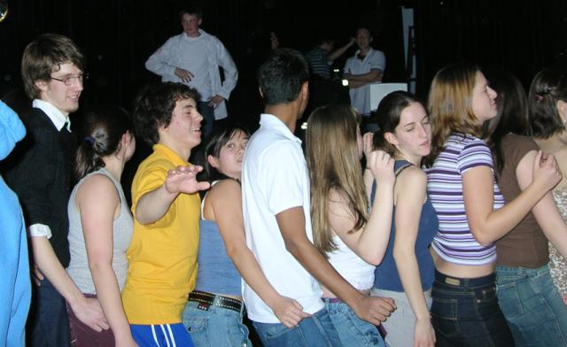
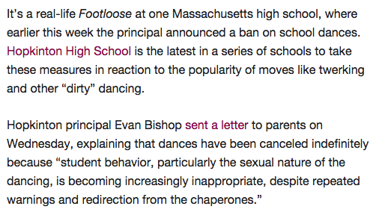

Slide 12
Eph. 4:17-20 Now this I say and testify in the Lord, that you must no longer walk as the Gentiles do, in the futility of their minds. ¹⁸ They are darkened in their understanding, alienated from the life of God because of the ignorance that is in them, due to their hardness of heart. ¹⁹ They have become callous and have given themselves up to sensuality, greedy to practice every kind of impurity. ²⁰ But that is not the way you learned Christ!
ESV

Slide 13
1 Pet. 4:3-4 For the time that is past suffices for doing what the Gentiles want to do, living in sensuality, passions, drunkenness, orgies, drinking parties, and lawless idolatry. ⁴ With respect to this they are surprised when you do not join them in the same flood of debauchery, and they malign you
ESV

Slide 14
ESV
Eph. 4:20-24 But that is not the way you learned Christ!— ²¹ assuming that you have heard about him and were taught in him, as the truth is in Jesus, ²² to put off your old self, which belongs to your former manner of life and is corrupt through deceitful desires, ²³ and to be renewed in the spirit of your minds, ²⁴ and to put on the new self, created after the likeness of God in true righteousness and holiness.

